Slide 1
MXNet Overview
Thom Lane
31st July 2018

Slide 2
Why MXNet?
Flexible & Debugable
Scalable
Portable

Slide 3
Quick History
Since 2015

Slide 4
Originated from DMLC
& many more…
Distributed Machine Learning Community
XGBoost
MinPy
MXNet

Slide 5
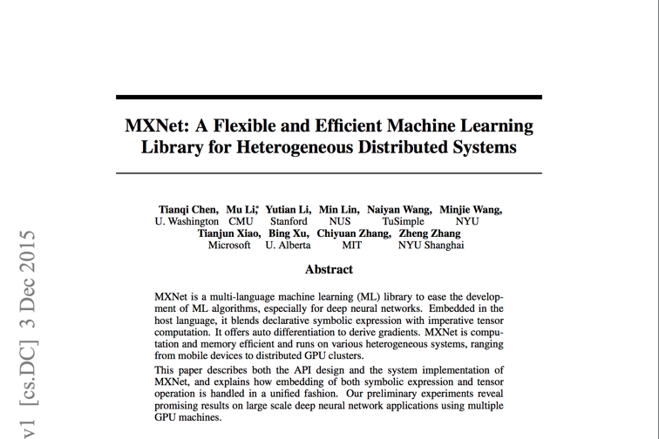
Original Paper in 2015
https://arxiv.org/pdf/1512.01274.pdf

Slide 6

Authors
Tianqi Chen UW
Mu Li
Amazon AI
Yutian Li
Stanford
Min Lin
MILA
Naiyan Wang
TuSimple
Minjie Wang
NYU CS
Tianjun Xiao
Tesla
Bing Xu
Apple AI
Chiyuan Zhang Google Brain
Zheng Zhang
MSR Asia

Slide 7
Major Events
Amazon’s deep-learning framework of choice
since November 2016.
Accepted into
Apache Incubator
in January 2017.

Slide 8
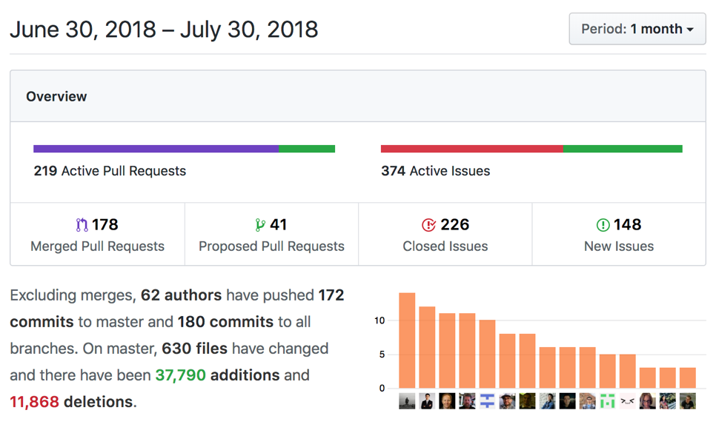
Current Activity

Slide 9
Architecture

Slide 10
Multi-language Support
While keeping high performance from efficient backend
R
Perl
Julia
Clojure
Python
Scala
C++
Frontend
Backend
C++

Slide 11
Optimized libraries
CUDA & CUDNN
MLK, MKLML & MKLDNN
e.g. pip install mxnet-cu92
e.g. pip install mxnet-mkl
e.g. pip install mxnet-cu92mkl
Also Atlas, OpenBLAS & Apple Accelerate.

Slide 12
Asynchronous Engine
Sync
Async
Operations appear to return immediately, but just pushed to engine queue on backend.
Allows for much greater parallelism.
Serial or parallel? “The execution of any two functions when one of them modifies at least one common variable is serialized in their push order.”
Must wait_to_read() or similar to retrieve value and this blocks.
backend
frontend
wait_to_read()

Slide 13
Python Core APIs
Module
(2016)
Gluon
(2017)
High Level APIs
Symbol
NDArray
Low Level APIs
Notes:
Used to be Model, but deprecated.

Slide 14
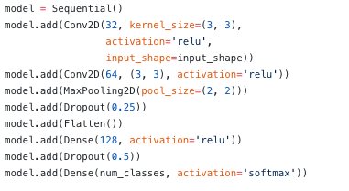
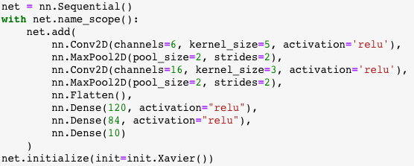
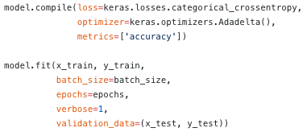
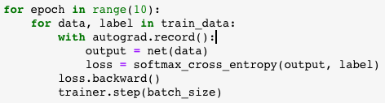
Symbolic vs Imperative
e.g. Inception Stage
Symbolic is “define, compile, run”
Imperative is “define-by-run”
Notes:
Imperative: easier to debug, flexible since can add dynamic control flow in host language.

Slide 15
Ecosystem & Community

Slide 16
Ecosystem
ONNX
Model Zoo
TVM
GluonCV
MXNet
Model Server
GluonNLP
MXBoard
Keras
Notes:
Model Zoo (Module, Gluon & ONNX)

Slide 17
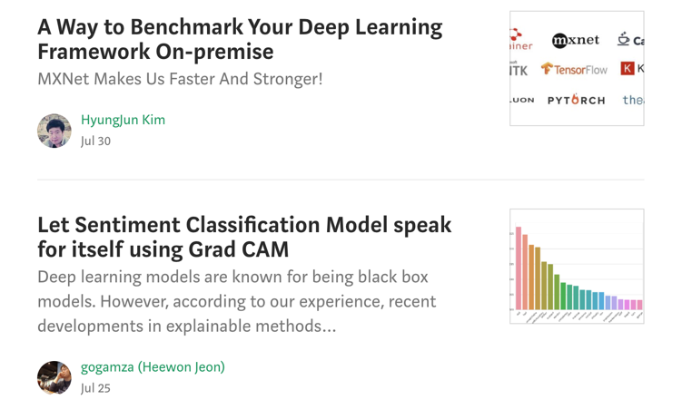
Keeping Up to Date
Medium: https://medium.com/apache-mxnet

Slide 18
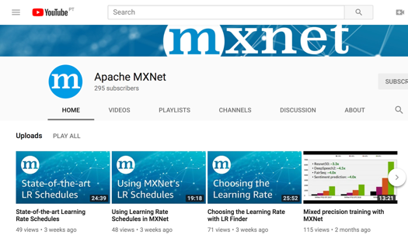
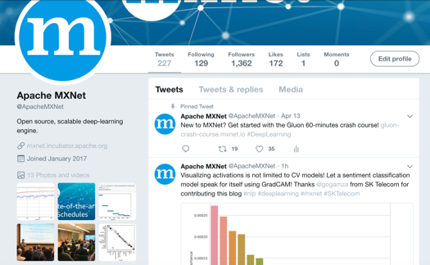
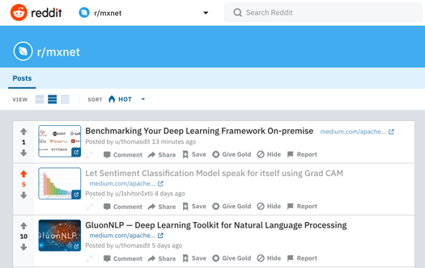
Keeping Up to Date: Social
YouTube: /apachemxnet
Twitter: @apachemxnet
Reddit: r/mxnet
Notes:
https://www.reddit.com/r/mxnet/

Slide 19
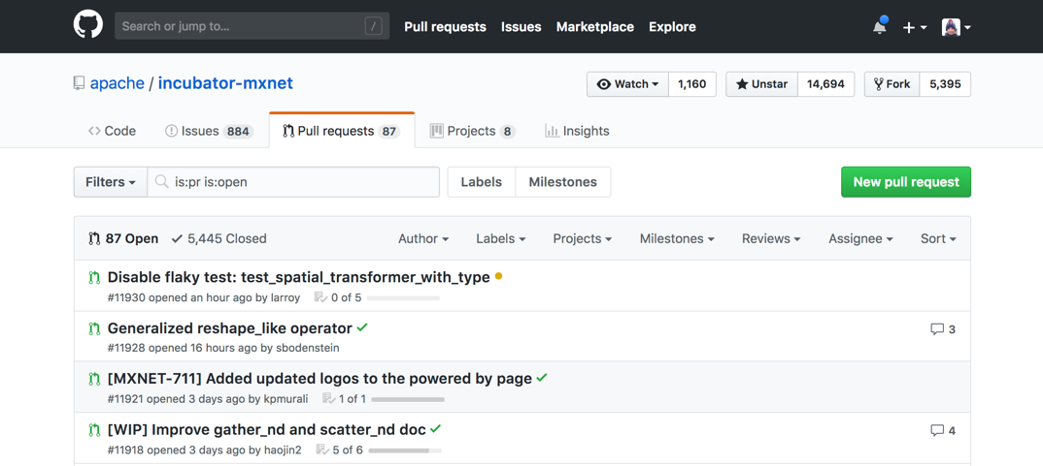
Community
GitHub: https://github.com/apache/incubator-mxnet

Slide 20
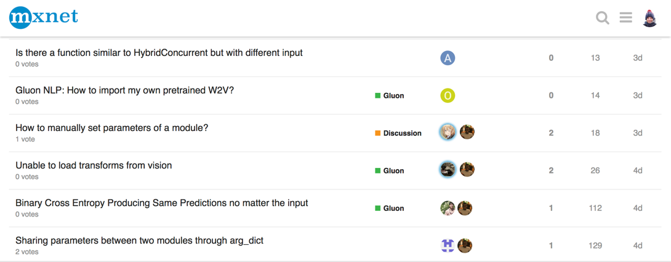
Community
Discuss Forum: https://discuss.mxnet.io/

